Slide 1
Projectwork its
Lavoro di De Luca Alessio, Granziera Matteo, Tedesco Nicola

Slide 2
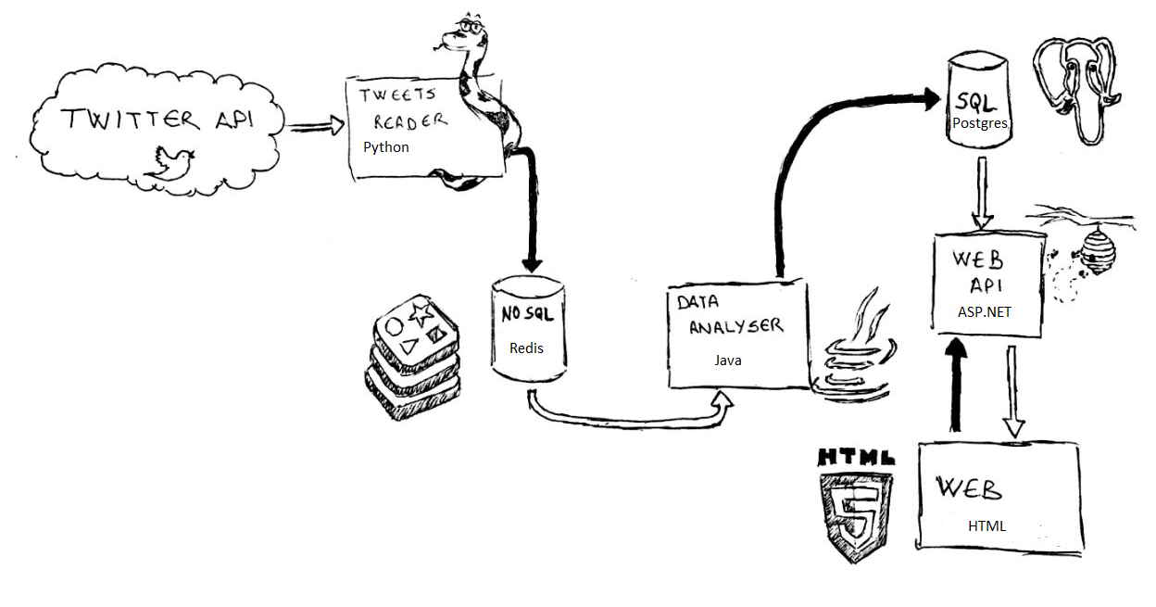
Diagramma del progetto

Slide 3


Fase 1 – Ricerca Tweets
Connection to Twitter.
Request of Countries and Languages to DB.
Request to Twitter and first data cleaning.
Insert data into Redis’s queue

Slide 4


Fase 2 – Data Analyzer
Read configuration files
Read from Redis’s queue
Clean Tweets
Put score results to postgres DB
Possibility of multi thread

Slide 5


Fase 3 – Web Site
Connect to our postgres database.
Structure queries to acces datas with WEB API.
Structure the webpage with all .css and .js files.
Use «Chart.js» library to do graphs .
Publish the project in Azure.

Slide 6
Thanks for your Attention

